Slide 1


Consumer Goods Ad_Hoc Insights

Slide 2
Objective
AtliQ Hardware (fictitious corporation) is one of the major computer
hardware manufacturers in India, with a strong presence in other
nations.
Nevertheless, the management did note that they do not have
sufficient insights to make prompt, wise, and data-informed
judgments.
Plan to expand the data analytics team by adding junior data analysts.
To assess candidates, Data analytics director, Tony Sharma plans to conduct a SQL challenge to evaluate both tech and soft skills.
The company seeks insights for 10 ad hoc requests.

Slide 3
Company Details AtliQ Hardware is a computer hardware and accessory manufacturer.
FISCAL YEAR
SEPTEMBER 2019 - AUGUST 2020
FY 2020
SEPTEMBER 2020 - AUGUST 2021
FY 2021
Inner Circle:
Division
Mid Circle:
Segment
Outer Circle:
Category

Slide 4
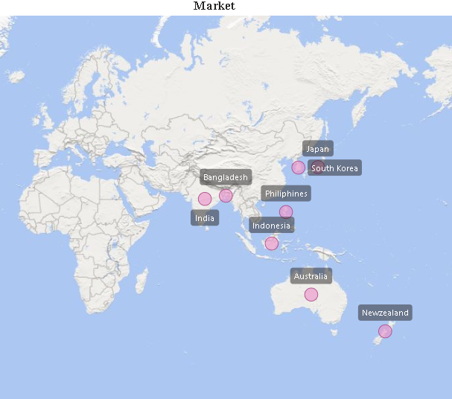
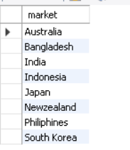
Yearly report for ‘croma’ customer
Question 1
Provide the list of markets in which customer “AtliQ Exclusive” operates its business in the APAC region.
Output

Slide 5
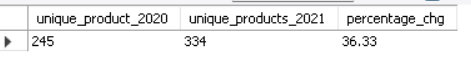
Yearly report for ‘croma’ customer
Question 2
What is the percentage of unique product increase in 2021 vs 2020? The final output contains these fields,
unique_products_2020
unique_products_2021
percentage_chg
Output

Slide 6
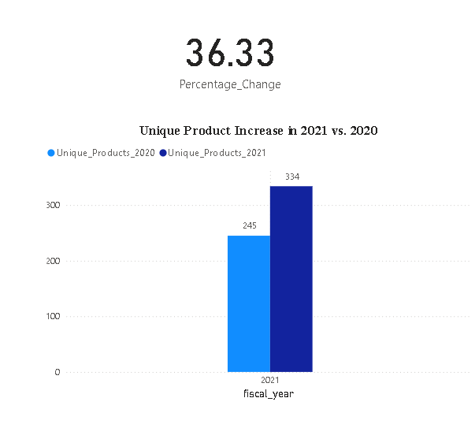
Conversion of Output to visual
Insights
According to the analysis, the variety of unique products sold in 2021 increased by 36.33% over 2020.

Slide 7
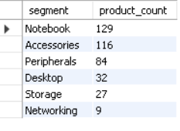
Yearly report for ‘croma’ customer
Question 3
Provide a report with all the unique product counts for each segment and sort them in descending order of product counts. The final output contains 2 fields, “segment” & “product_count”
s
Output

Slide 8
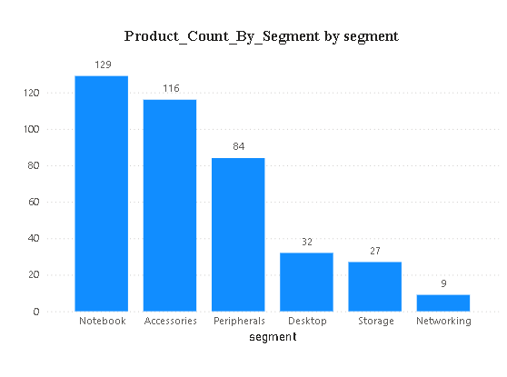
Conversion of Output to visual
Insights
Results indicates that Segment with higher product counts may represent areas of strong market demand. The Notebook and Accessories segments lead with the highest unique product counts, 129 and 116 respectively.
Opportunities for expansion and innovation are necessary for segment with fewer unique products

Slide 9
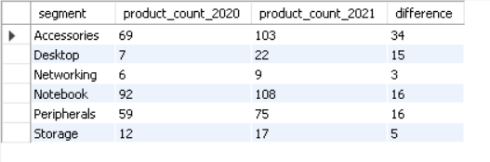
Yearly report for ‘croma’ customer
Question 4
Follow up: Which segment had the most increase in unique products in 2021 vs 2020? The final output contains these fields, “segment”, “product_count_2020”, “product_count_2021” and “difference“
Output

Slide 10
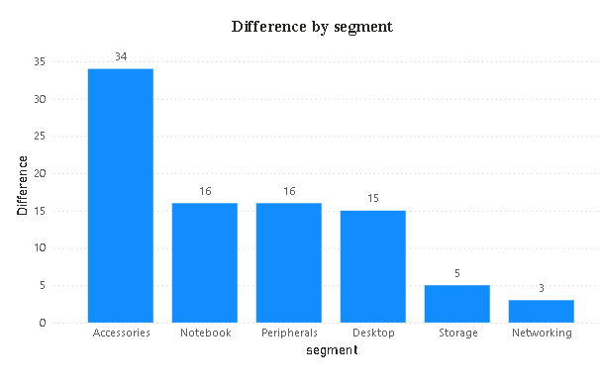
Conversion of Output to visual
Insights
The Accessories segment experienced the highest growth in unique products, with an increase of 34 products from 2020 to 2021.
While Networking and Storage exhibited smaller growth, their consistent upward trend suggests opportunities to explore further innovation and expansion in these areas.

Slide 11
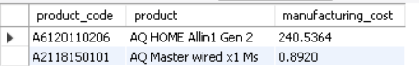
Yearly report for ‘croma’ customer
Question 5
Get the products that have highest and lowest manufacturing costs. The final output should contain these fields, “product_code”,”product”, “manufacturing_cost.”
Output

Slide 12
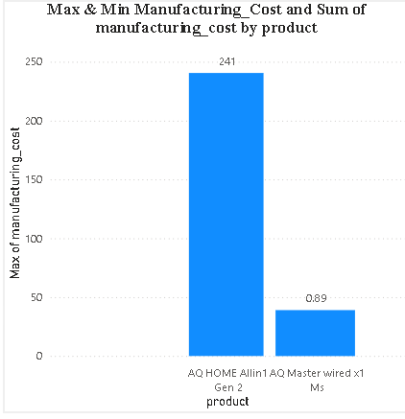
Conversion of Output to visual
Insights
The product "AQ HOME Allin 1 Gen 2" (product code A6120110206) has the highest manufacturing cost of 240.5364
This could indicate that the product involves higher production complexity, premium materials, or specialized components, making it a potential focus for margin optimization or cost analysis.

Slide 13
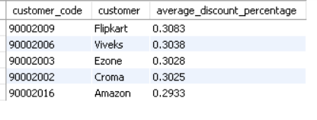
Yearly report for ‘croma’ customer
Question 6
Generate a report which contains the top 5 customers who received an average high pre_invoice_discount_pct for the fiscal year 2021 and in the Indian market. The final output contains these fields, “customer_code”, “customer”, “average_discount_percentage”
Output

Slide 14
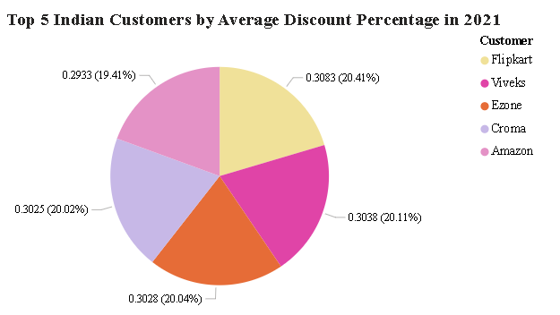
Conversion of Output to visual
Insights
The top five customers, including Flipkart (0.3083), Viveks (0.3038), and Ezone (0.3028), have received the highest average pre-invoice discounts in the Indian market for fiscal year 2021.
This suggests that these customers may be involved in high-volume transactions or strategic partnerships that warrant significant discounts.

Slide 15
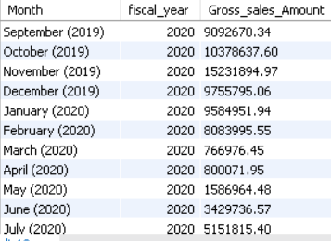
Yearly report for ‘croma’ customer
Question 7
Get the complete report of the Gross Sales Amount for the customer “AtliQ Exclusive” for each month. This analysis helps to get an idea of low and high-performing months and take strategic decisions. The final report contains these columns: “Month”, “Year”, “Gross Sales Amount”.
Output

Slide 16
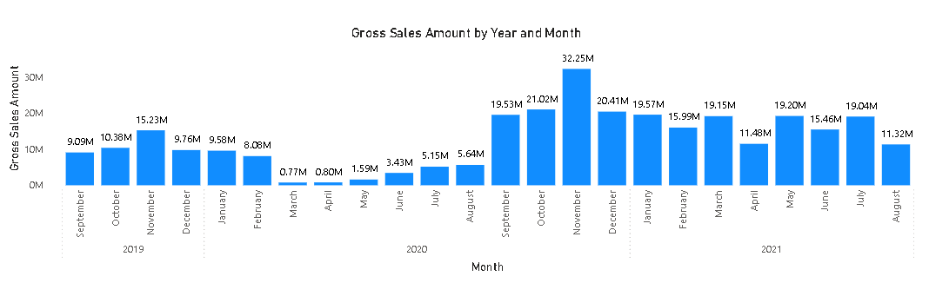
Conversion of Output to visual
Insights
By identifying underperforming months, the company can explore potential causes such as lack of promotions, reduced customer engagement, or inventory challenges.
These insights allow for proactive measures, like launching time-specific discounts or improving product availability, to enhance sales performance.

Slide 17
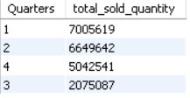
Yearly report for ‘croma’ customer
Question 8
In which quarter of 2020, got the maximum total_sold_quantity? The final output contains these fields sorted by the total_sold_quantity, “Quarter”,”total_sold_quantity “
Output

Slide 18
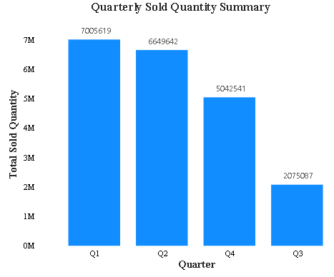
Conversion of Output to visual
Insights
The first quarter of 2020 recorded the highest total quantity sold at 7,005,619 units, indicating a strong demand during this period.
This could be attributed to specific seasonal trends, promotional campaigns, or new product launches.

Slide 19
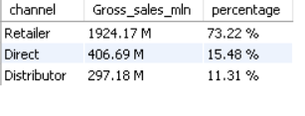
Yearly report for ‘croma’ customer
Question 9
Which channel helped to bring more gross sales in the fiscal year 2021 and percentage of contribution? The final output contain these fields, “channel”, “gross_sales_mln”, “percentage”
Output

Slide 20
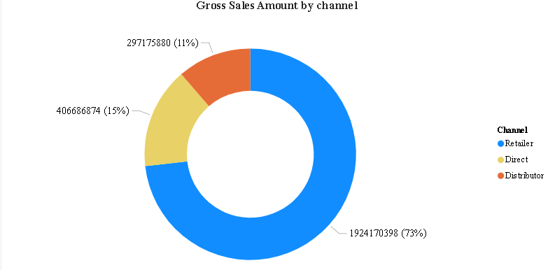
Conversion of Output to visual
Insights
The Retailer channel contributed the highest gross sales in fiscal year 2021, generating $1924.17M, which accounts for a substantial 73.22% of the total sales.
The Direct channel and Distributor channel contributed 15.48% and 11.31%, respectively, with gross sales of $406.69M and $297.18M. While their contributions are smaller compared to retailers, they remain valuable for diversifying revenue streams and reaching different customer segments.

Slide 21
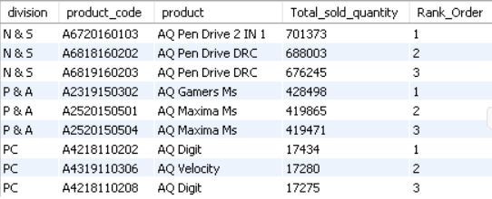
Yearly report for ‘croma’ customer
Question 10
Get the Top 3 products in each division that have a highest total_sold_quantity in the fiscal_year=2021? The final output contains these fields “division”, “product_code”, “product”, “total_sold_quantity”, “rank_order”
Output

Slide 22
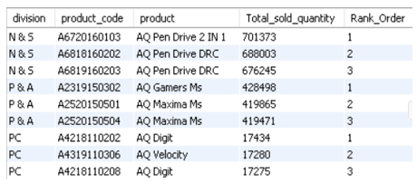
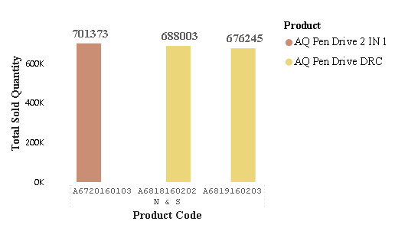
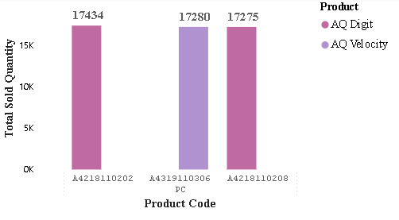
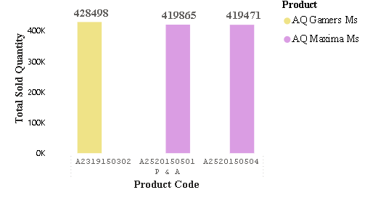
Conversion of Output to visual
Insights
N & S: Dominated by AQ Pen Drive 2 IN 1 (701,373 units), followed by AQ Pen Drive DRC.
P & A: AQ Gamers Ms leads (428,498 units), with AQ Maxima Ms variants close behind.
PC: AQ Digit tops (17,434 units), with tight competition among the top three.

